Slide 1
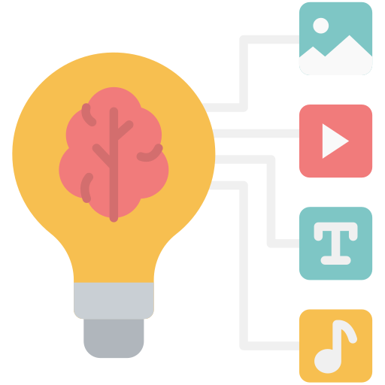
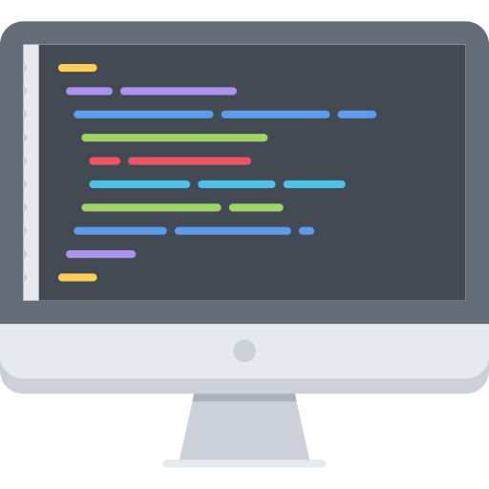
Core Python Programming Foundation
Misr International University
AI Summer Camp – Day 1
Day 1

Slide 2
What is Artificial Intelligence (AI) ?
Misr International University
What is AI?
How do we program it?
It's the field of creating machines that
can reason, learn, and act intelligently,
often mimicking human cognitive
abilities. Think of AI in action:
Voice Assistants
Recommendation Systems
Facial Recognition
Self-driving cars
AI systems are fundamentally built from
the ground up using code. To truly
understand, build, and innovate in AI,
you need to speak its language. We use
programming languages like Python to:
Instruct Machines
Process Data
Design Algorithms
Automate Complex Tasks
Input Data
Code (Brain)
Intelligent Output
AI is no longer science fiction; it's seamlessly integrated into our daily lives!
Day 1

Slide 3
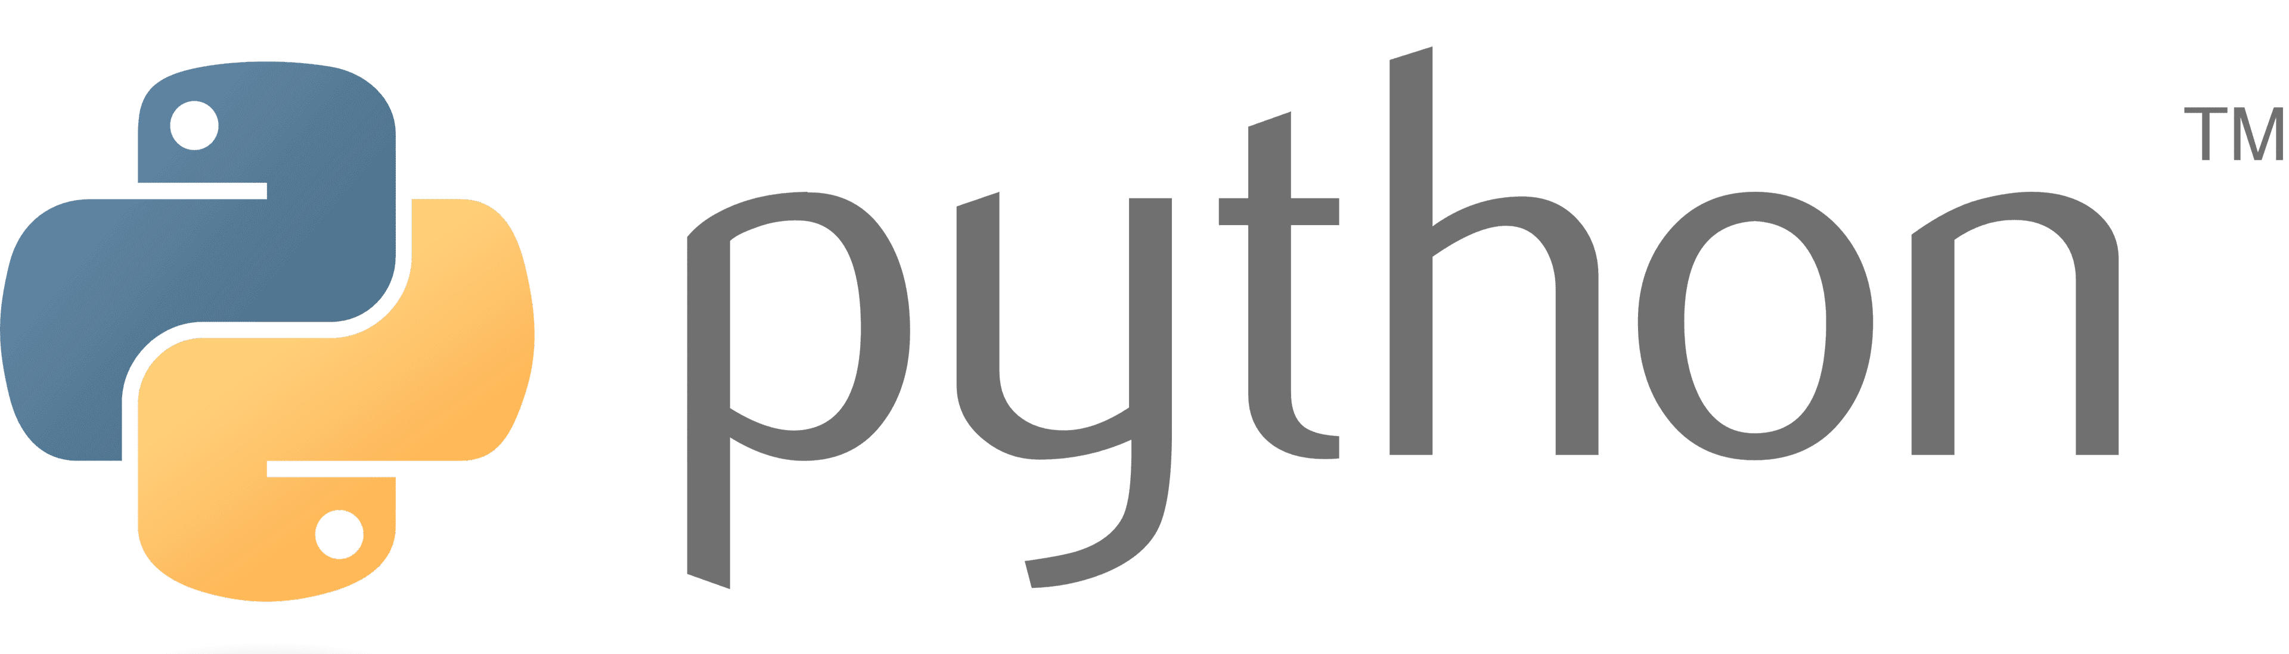
Misr International University
What is python?
Day 1

Slide 4
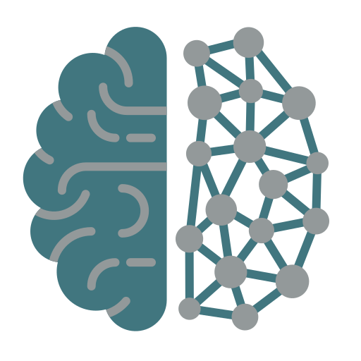
Python is a high-level, interpreted, general-purpose programming language
Misr International University
Programming languages translate human logic into machine instructions, with different approaches and complexities. Popular examples include:
  C++: System software, game development, embedded systems
  Java: Enterprise applications, Android apps
  JavaScript: Web development (front-end and back-end)
  Swift: iOS mobile applications
  Python: AI/Data Science, automation, web development
Human Logic
Machine Instructions
Day 1

Slide 5
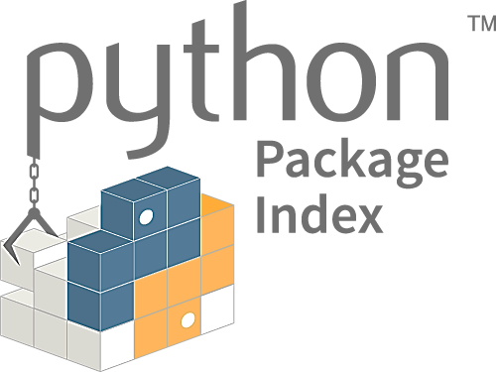
Python is a high-level, interpreted, general-purpose programming language
Misr International University
Python is exceptionally beginner-friendly and powerful, allowing developers to focus on solving problems rather than managing technical complexity. Its versatility allows it to be used across a vast array of applications:
Web Development - Scientific Computing - AI/Machine Learning - Automation & Scripting
What makes it general purpose?
Rich Ecosystem: The Python Package Index (PyPI) hosts thousands of pre-built modules
that reduce the need to write code from scratch.
Strong Community Support: Python boasts one of the largest and most active global developer communities, with extensive documentation, tutorials, and constant library growth.
Platform Independence: Python runs smoothly on various operating systems (Windows, macOS, Linux) with little to no code changes.
Day 1

Slide 6
Python is a high-level, interpreted, general-purpose programming language
Misr International University
Compilation Vs Interpretation
Source code is translated fully into machine code before running (e.g., C, C++)
Source code is executed line-by-line at runtime by an interpreter (e.g., Python, JavaScript)
Why Python Being Interpreted Is an Advantage
Faster Development: No compilation step, just write and run
Interactive Development: Allows for live experimentation
Dynamic Features: Modify code, types, and objects at runtime
Easier Debugging: Clear error messages with real-time fixes
Rapid Prototyping: Ideal for quick tests, data work, and iteration
Day 1

Slide 7
Python is a high-level, interpreted, general-purpose programming language
Misr International University
Python abstracts away hardware complexity and memory management, allowing you to write code using human-like syntax and mathematical notation instead of low-level machine instructions.
#include <iostream>
#include <vector>
#include <numeric>
#include <iomanip>
int main() {
std::vector<int> numbers = {10, 20, 30, 40, 50};
if (numbers.empty()) {
std::cerr << "Error: Cannot calculate average of empty vector" << std::endl;
return 1;
}
int sum = std::accumulate(numbers.begin(), numbers.end(), 0);
double average = static_cast<double>(sum) / numbers.size();
std::cout << "The average is: " << std::fixed << std::setprecision(1) << average << std::endl; return 0;
}
// Output: The average is: 30.0
Other Programming Languages (C++) Vs
Python
numbers = [10, 20, 30, 40, 50]
if not numbers:
print("Error: Cannot calculate average of
empty list")
else:
average = sum(numbers) / len(numbers)
print(f"The average is: {average:.1f}")
# Output: The average is: 30.0
Day 1

Slide 8


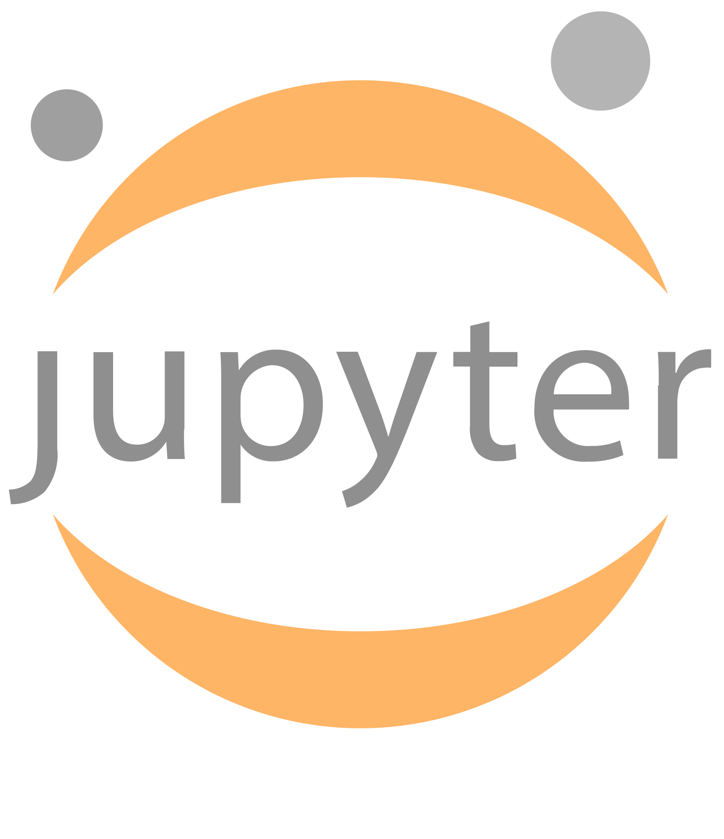
Tools used when coding with python
Misr International University
AI Workbench:
A programming environment is the setup where you write, run, and test code. However, setting one up locally can be tricky for beginners
Google Colab is a cloud-based environment that needs no setup
Based on Jupyter Notebooks, which support:
    Code Cells: Run Python code
    Text Cells: Add notes using Markdown
Day 1

Slide 9
Why use google colab?
No Setup Needed
Interactive Format
Free Hardware Access
Easy Collaboration
Misr International University
Pre-installed Python + AI libraries
Mix explanations with live code
Use Google’s powerful GPUs & TPUs
Share and collaborate in real-time
Day 1

Slide 10
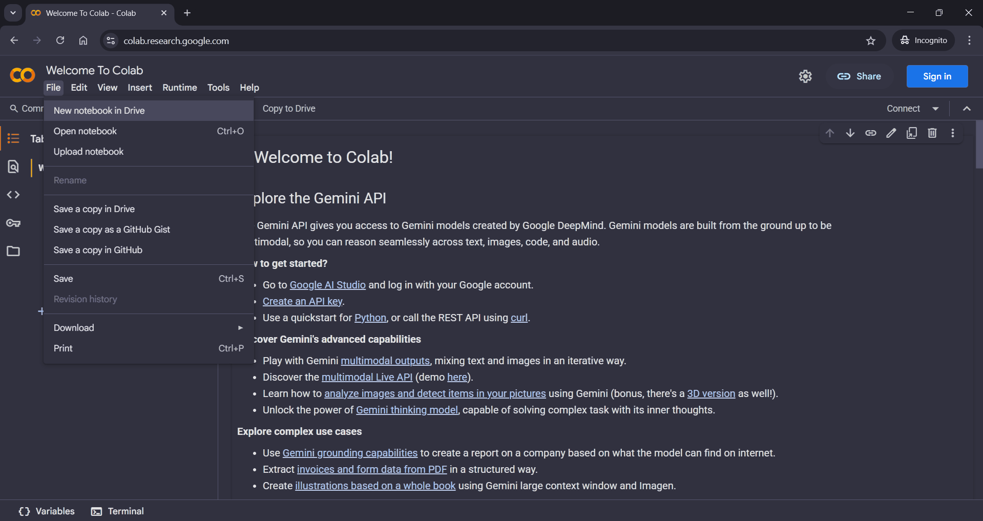
How to get started?
colab.research.google.com
Misr International University
Day 1

